Slide 1
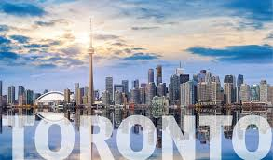
Battle of Neighborhoods
Coffee Beans & Tea Leaf in Toronto
By: David Liu

Slide 2
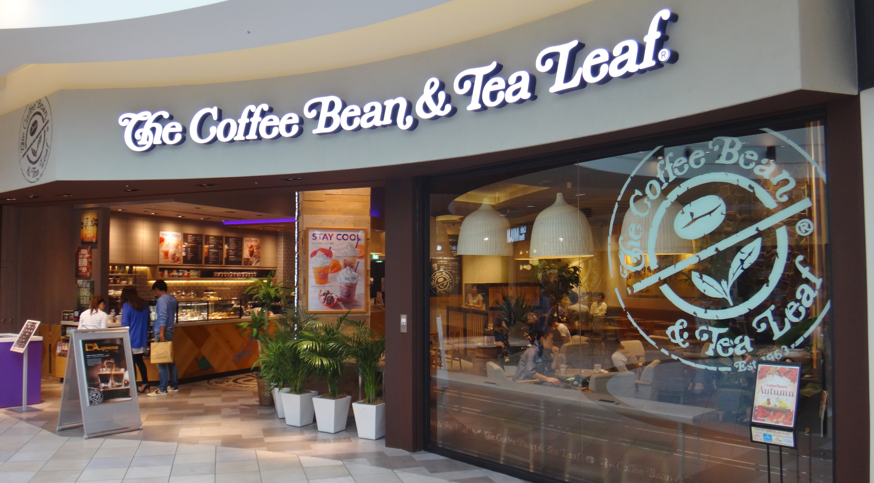
Introduction
Among all the widely consumed beverages in the world, coffee and tea is consider the top selection. In Canada, according to Coffee Association of Canada the coffee industry is a $6.2 billion industries with over 5,000 independent cafe and coffee shops. Beside independent coffee shops, you have major chain coffee shop like Starbucks, Country Styles, Second Cup and the biggest of them all Tim Horton's with over 3,800 locations.
Coffee Beans & Tea Leaf started in 1963. The company began to import, roast and sell gourmet coffee in Los Angeles, California in 1963 after the founder discovered quality coffee in Sweden during their honeymoon. Innovations included selling whole beans, touting their country of origins and allowing customers to observe the beans being roasted and sample varieties before making a purchase. Also in 1987 creating the first coffee ice blended drink before Starbucks. Today, They operate in 32 countries and over 1000 locations.
However, Coffee Beans & Tea Leaf has zero location in Canada.

Slide 3
Problem Statement
“What if Coffee Beans and Tea Leaf decided to expand to Toronto and where will the hotspot be?”
My goal is to find the area in Toronto where Coffee Beans and Tea Leaf company should open their first location where are plenty of coffee drinkers. Plenty of coffee drinkers allow you to have a test site and data to gauge if there is a market for expansion in Canada.

Slide 4
Objective
Collect Neighborhood information with BeautifulSoup
Collect Coffee Shop info with Foursquare API with request
Use Geopy to Map Plot Toronto current Coffee Shop location
Use Folium Plugins MarkerCluster to pinpoint Coffee Shop hotspot
Conclude my findings

Slide 5
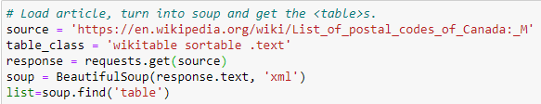
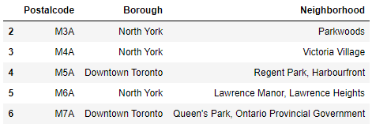
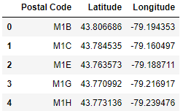
Data Gathering
We first gather neighborhood information in Toronto with Beautiful Soup.
Use the csv file to create geographical coordinates of a given postal code.

Slide 6
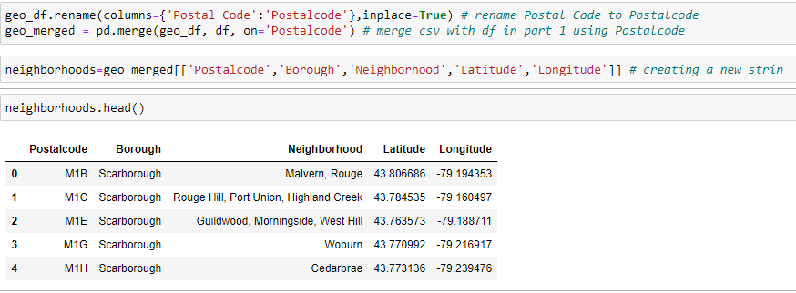
Data Gathering Cont’d
After we collect the Neighborhoods of Toronto and geographical coordinates for postal codes. We combined the information into a single dataframe and cleanse the data.
The Result: There is 103 Neighborhoods in Toronto

Slide 7
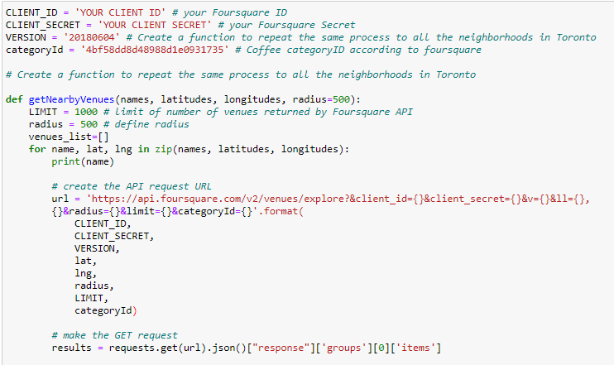
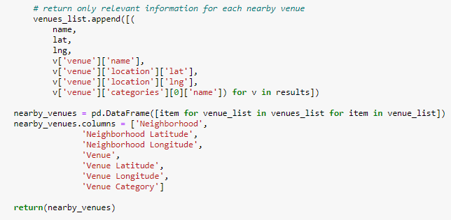
FourSquare API
Now we need to use Request to collect Coffee Shop info with Foursquare API.
Please note category ID is available in foursquare developers.
https://developer.foursquare.com/docs/build-with-foursquare/categories/

Slide 8
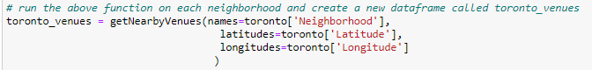
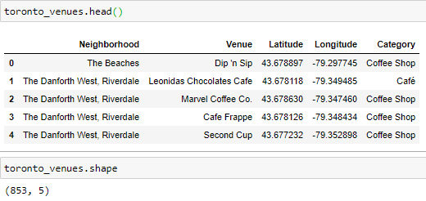
FourSquare API Cont’d
We run the codes with the Neighborhood data in FourSquare.
We clean up the data once more to make the data easier to read.
The result: There is 853 coffee and café located in Toronto area.
Analysis: As mention earlier in introduction. There is over 5,000 shop in Canada. Toronto represent approx. 17% of all shops in Canada.

Slide 9
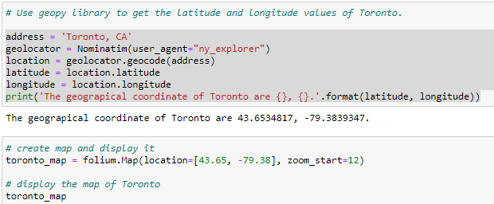
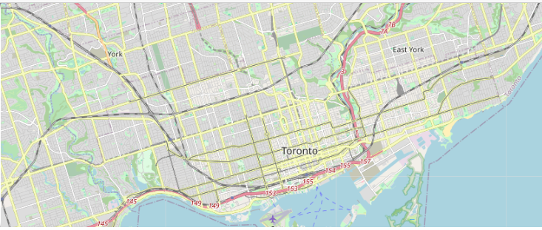
Map Plotting
We will use Folium Map and Geopy to create Toronto Map.
Facts.
Toronto is the most populated metropolitan area in Canada with a population of 5.9 million resident almost 2 million more than the next most populated area, Montreal. The population density in the City of Toronto is 11,226 per square miles.

Slide 10
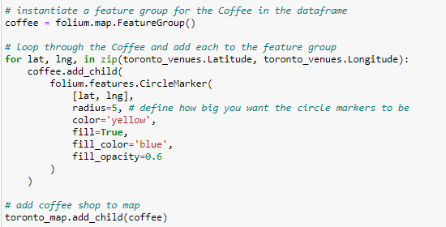
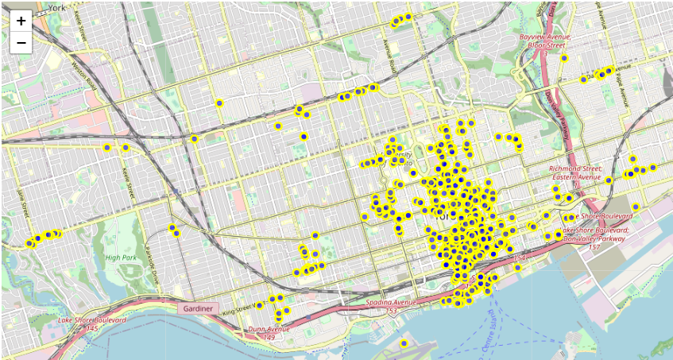
Map Plotting Cont’d
We will now add the coffee and café location into Toronto Map.
Observation:
As you see there is high density of coffee and café stores concentrated. However it is too dense to determine a location.

Slide 11
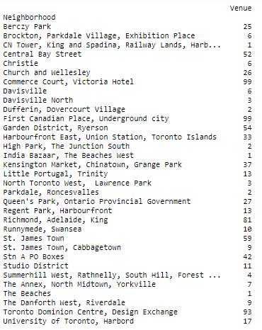
Bar Graph
To help pinpoint the neighborhood we will group the 853 coffee stores we will group the stores into neighborhood.
We will also remove unnecessary information to make data cleaner.

Slide 12
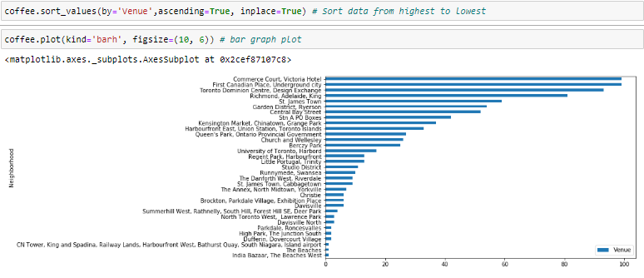
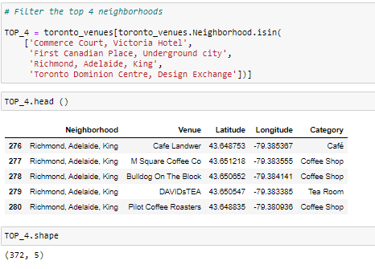
Bar Graph Cont’d
We will now observe the group neighborhood data in a barh (Horizontal bar) chart.
Observation:
From the Bar chart we can see 4 neighborhood has significantly more store location than the other neighborhoods. We will then take the top 4 to create a new dataframe. The top 4 location has 372 stores out of the original 853 stores in Toronto.

Slide 13
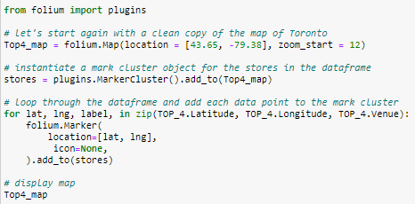
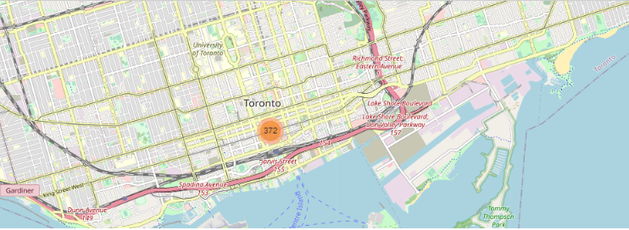
Mark Cluster the Top 4 Neighborhood
We will take the Top 4 Neighborhood found in the Bar Graph and create a MarkerCluster on a map to see where has the densest area of coffee shop.

Slide 14
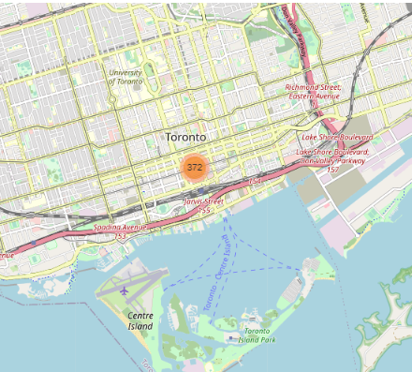
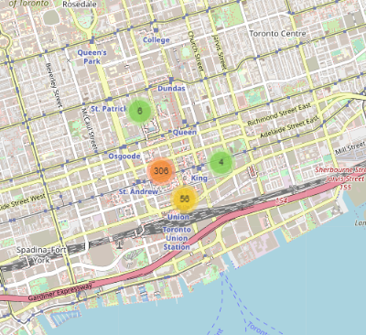
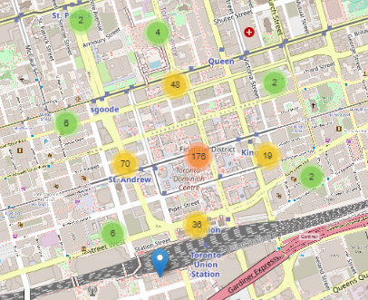
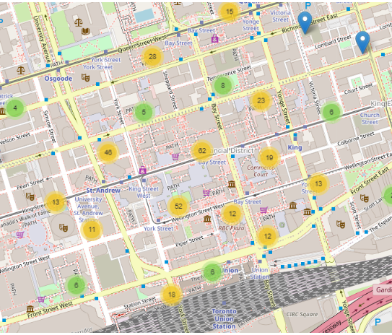
Mark Cluster the Top 4 Neighborhood
Observation:
As we look at the Global Cluster we can see all 372 stores is concentrated in area. As we zoom in +2 and +3, we see the majority of the coffee and café shop is in the Financial District. From our data, Financial District is not a specific neighborhood but it is made of several neighborhoods.
Global Cluster zoom: 12 Global Cluster zoom +1 Global Cluster zoom +2 Global Cluster zoom +3

Slide 15
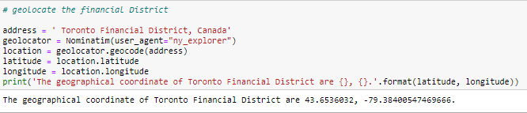
Result and Conclusion
From our data research our result is the best area to for Coffee Beans & Tea Leaf is in Toronto Financial District.
Below is the geographical coordinate of Toronto Financial District.
This Analysis concludes our research in looking for a location where there is a demand for coffee based off of coffee venue found in FourSquares. From our MarkerCluster we find there is 176 location in Toronto Financial District surrounding neighborhoods.
THANK YOU !!!

